Slide 1
Introduction to github
Instructor – Zach martin

Slide 2
Initial resources and Introductions
https://github.zach-martin.com
Download and install git-scm for your OS
Download and install GitHub Desktop
Download and install Visual Studio Code
While that is downloading… A quick introduction and question –
Zach Martin
14 years IT experience
4 years professional software development experience
Father to a six-month-old baby girl
What do you hope to learn today?

Slide 3
Presentation Objectives
Agnostic view of git, separate from github
Then how and why of using git
Labs involving both command-line and GUI driven git interaction
Branching strategies and conventions
GitHub features beyond git
Issue tracking
Actions

Slide 4
GIThub uses git (surprise!)
What is git?
Git is a VCS (Version Control System)
Examples of other VCS
Subversion
CVS
Mercurial
Monotone

Slide 5
Version Control System
Any VCS should have at minimum the following:
Complete history of changes for all files
Branching and merging by authorized users
Traceability
Does Software Development Require VCS?
Strictly speaking – no (but you’ll regret it!)

Slide 6
OK, So why git?
Works offline
Branching is easy
Merging is easy
Full history is kept in each repository copy
It’s fast… really fast!

Slide 7
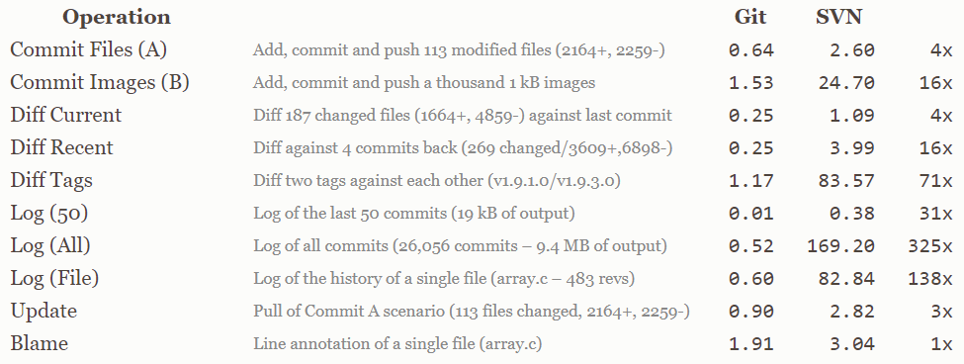
OK, So why git? (Continued)

Slide 8
Important terms
Repository
Clone
Branch
Status
Stage
Stash
Commit
Merge
Push
Pull
Fetch
Fork

Slide 9
Lab 1 – part 1
Install git-bash
Let git know who you are
git config --global user.email "MyEmail@Email.com"
git config --global user.name "My Name"

Slide 10
Lab 1 – part 2
Init a new local repository
Add file to be staged
Commit file
Create a new, empty repository in github
Add remote repository as upstream
Push repository to github
Confirm your local repository exists in github

Slide 11
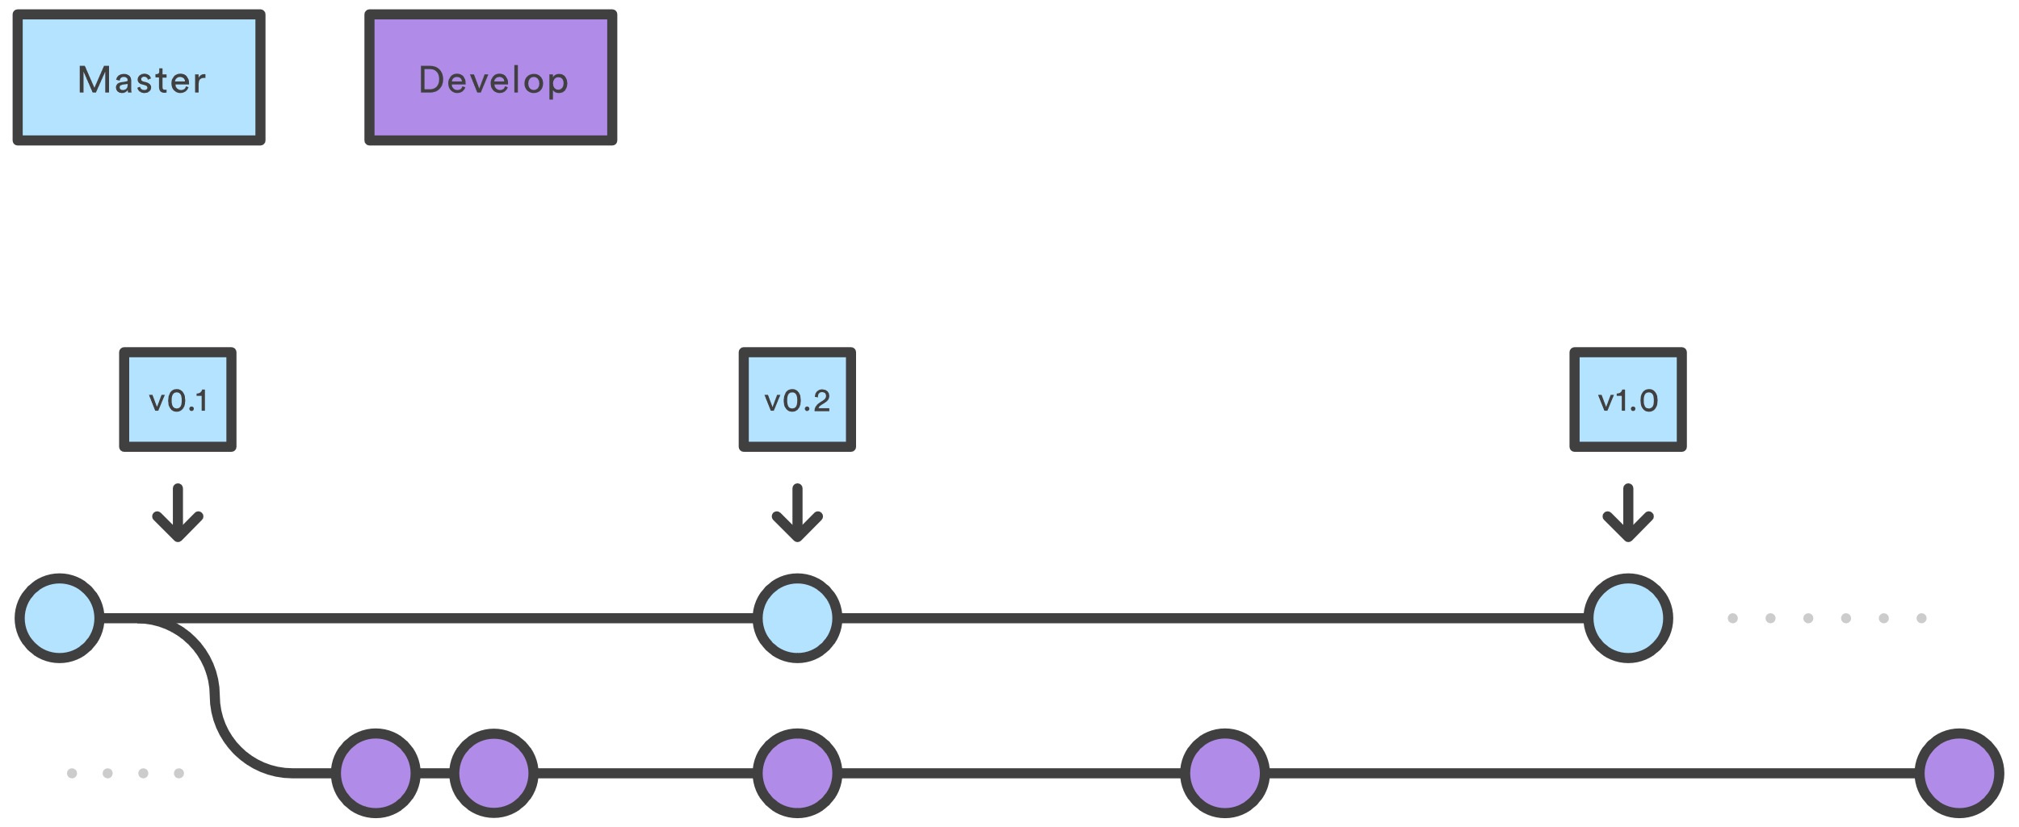
Branching strategies - Gitflow

Slide 12
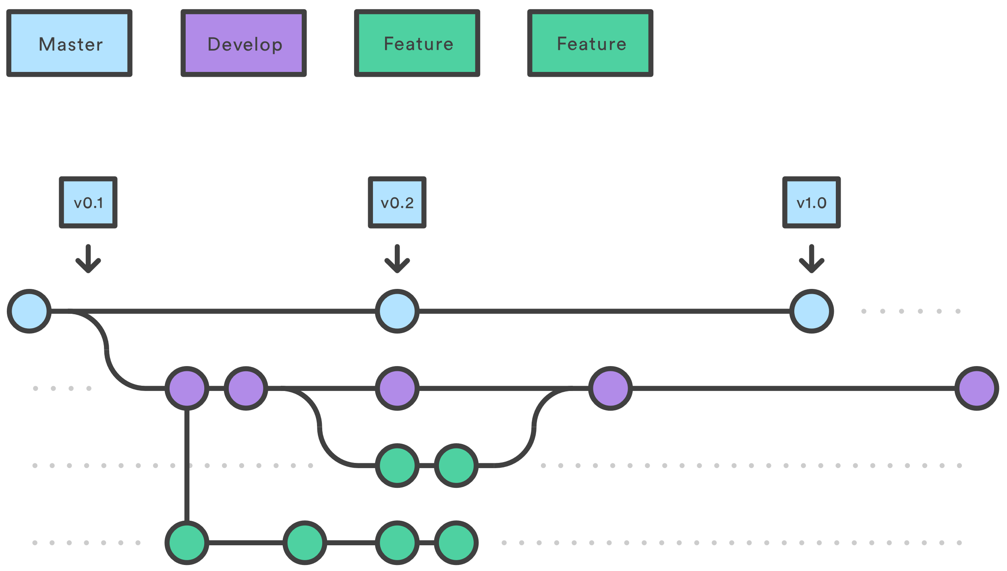
Branching strategies – Gitflow (Cont.)

Slide 13
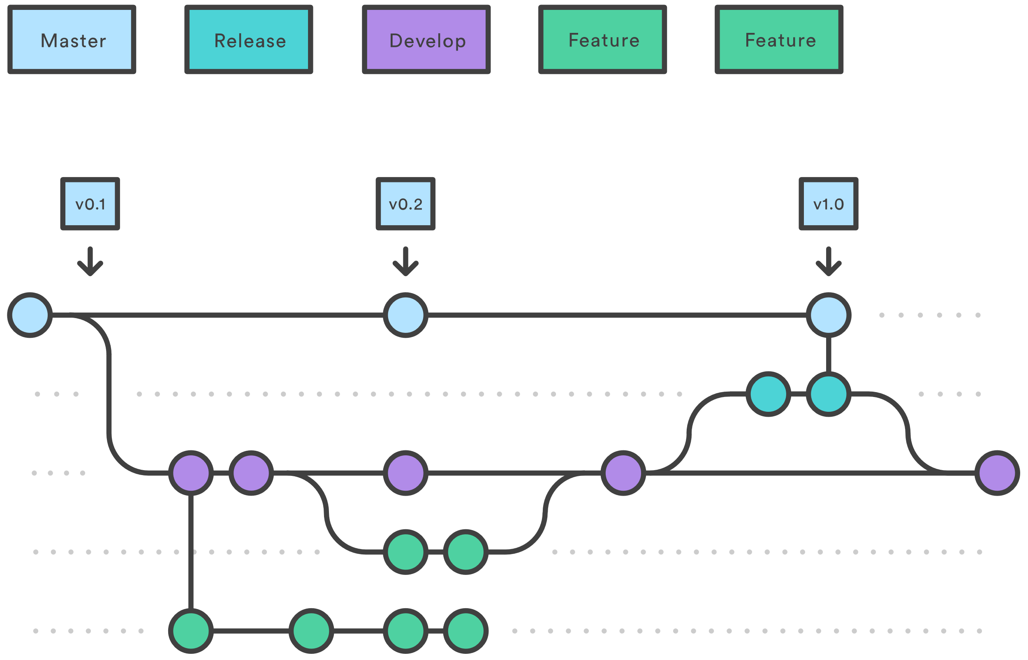
Branching strategies – Gitflow (Cont.)

Slide 14
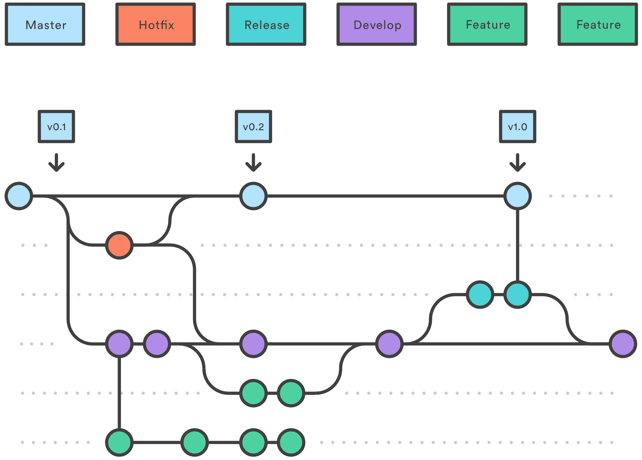
Branching strategies – Gitflow (Cont.)

Slide 15
Lab 2
Create another repository in github
Repository will be initialized by github
Clone repository
Create branch
Make change
Commit change
Push
Merge branch

Slide 16
Conflict is inevitable
Unless you are working on a project by yourself, it will likely be almost impossible to avoid merge conflicts
Managing conflicts can be challenging
Different strategies exist, but our next lab will be the most likely resolution strategy
Rebasing is another strategy we’ll discuss post-lab

Slide 17
Lab 3
For this lab, we’ll use GitHub Desktop
Use the second repository we created as our starting point
Create a new branch, the name is unimportant
Switch back to master (GitHub Desktop switches to the newly created branch by default)
Update the README.md file
Commit changes
Switch to your new branch
Update the README.md file on the same line
Commit changes
Switch to master branch
Attempt to merge your new branch into master
Resolve conflict

Slide 18
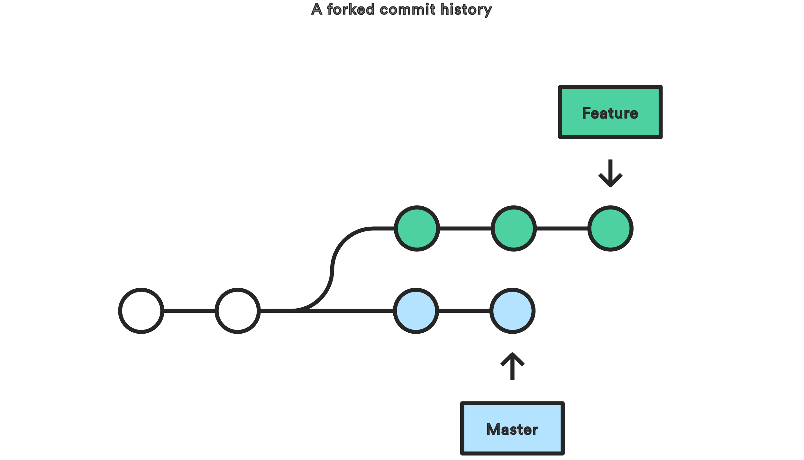
Rebase – Tread carefully

Slide 19
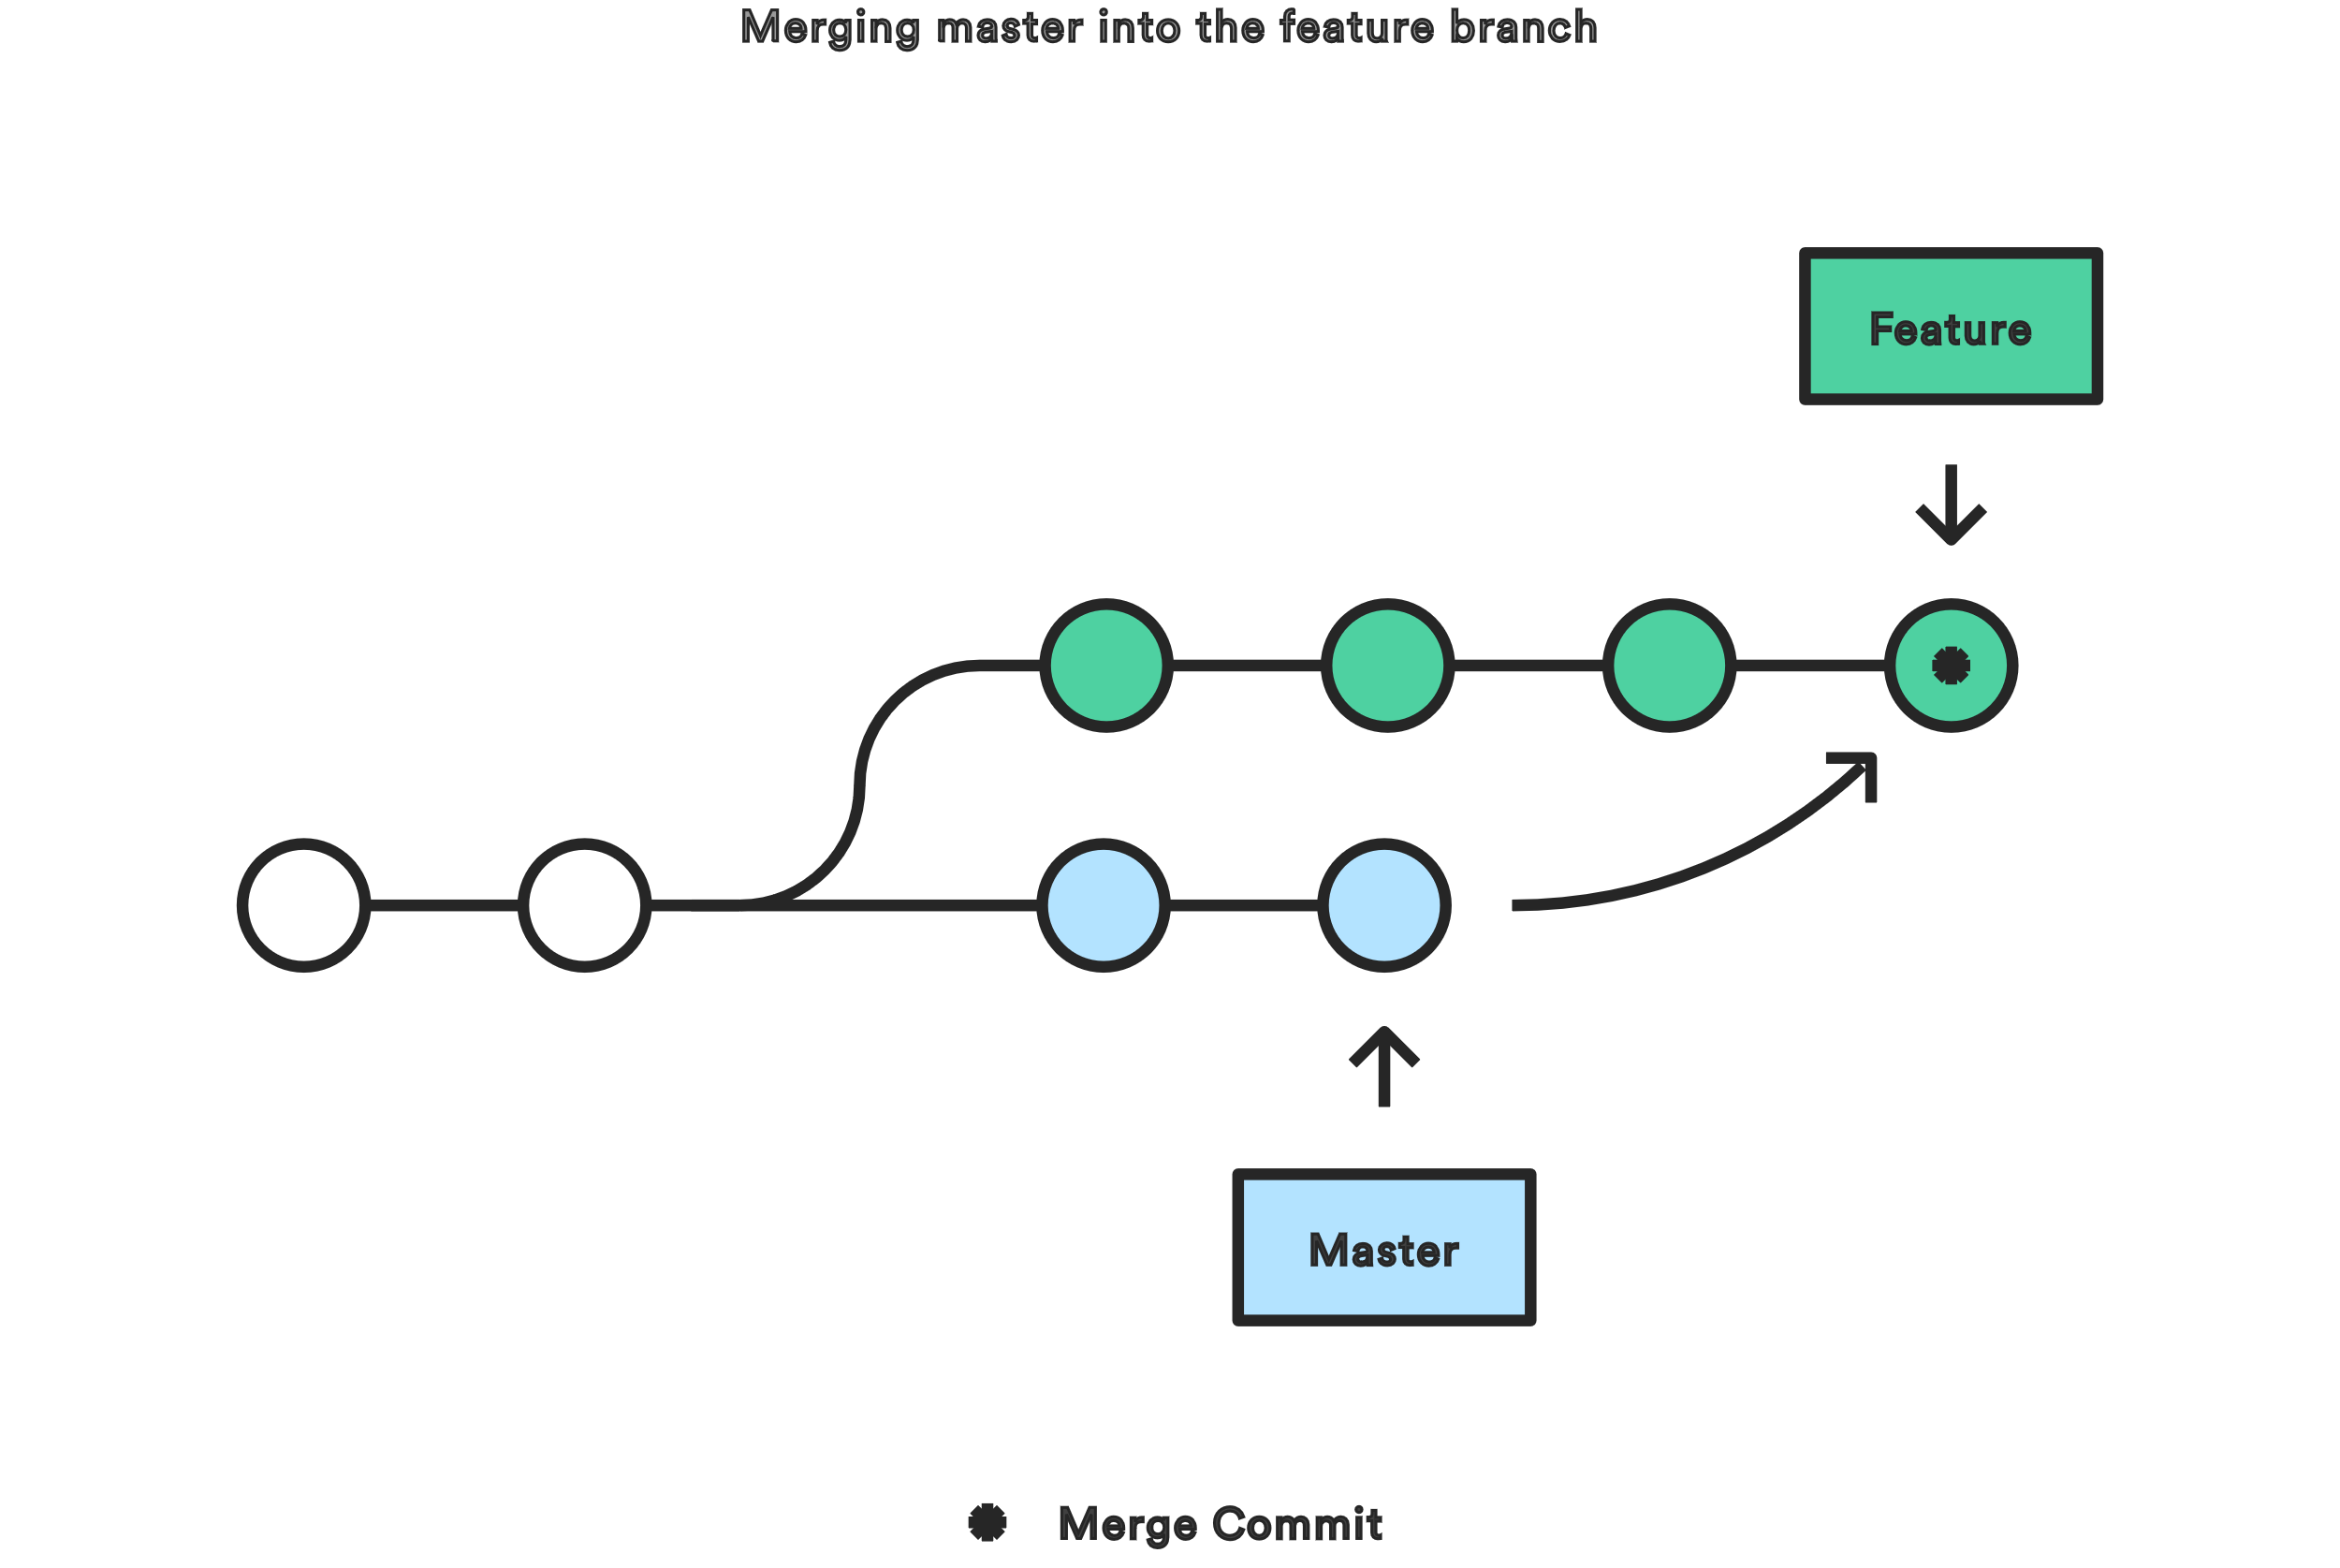
Rebase – Tread carefully (Cont.)

Slide 20
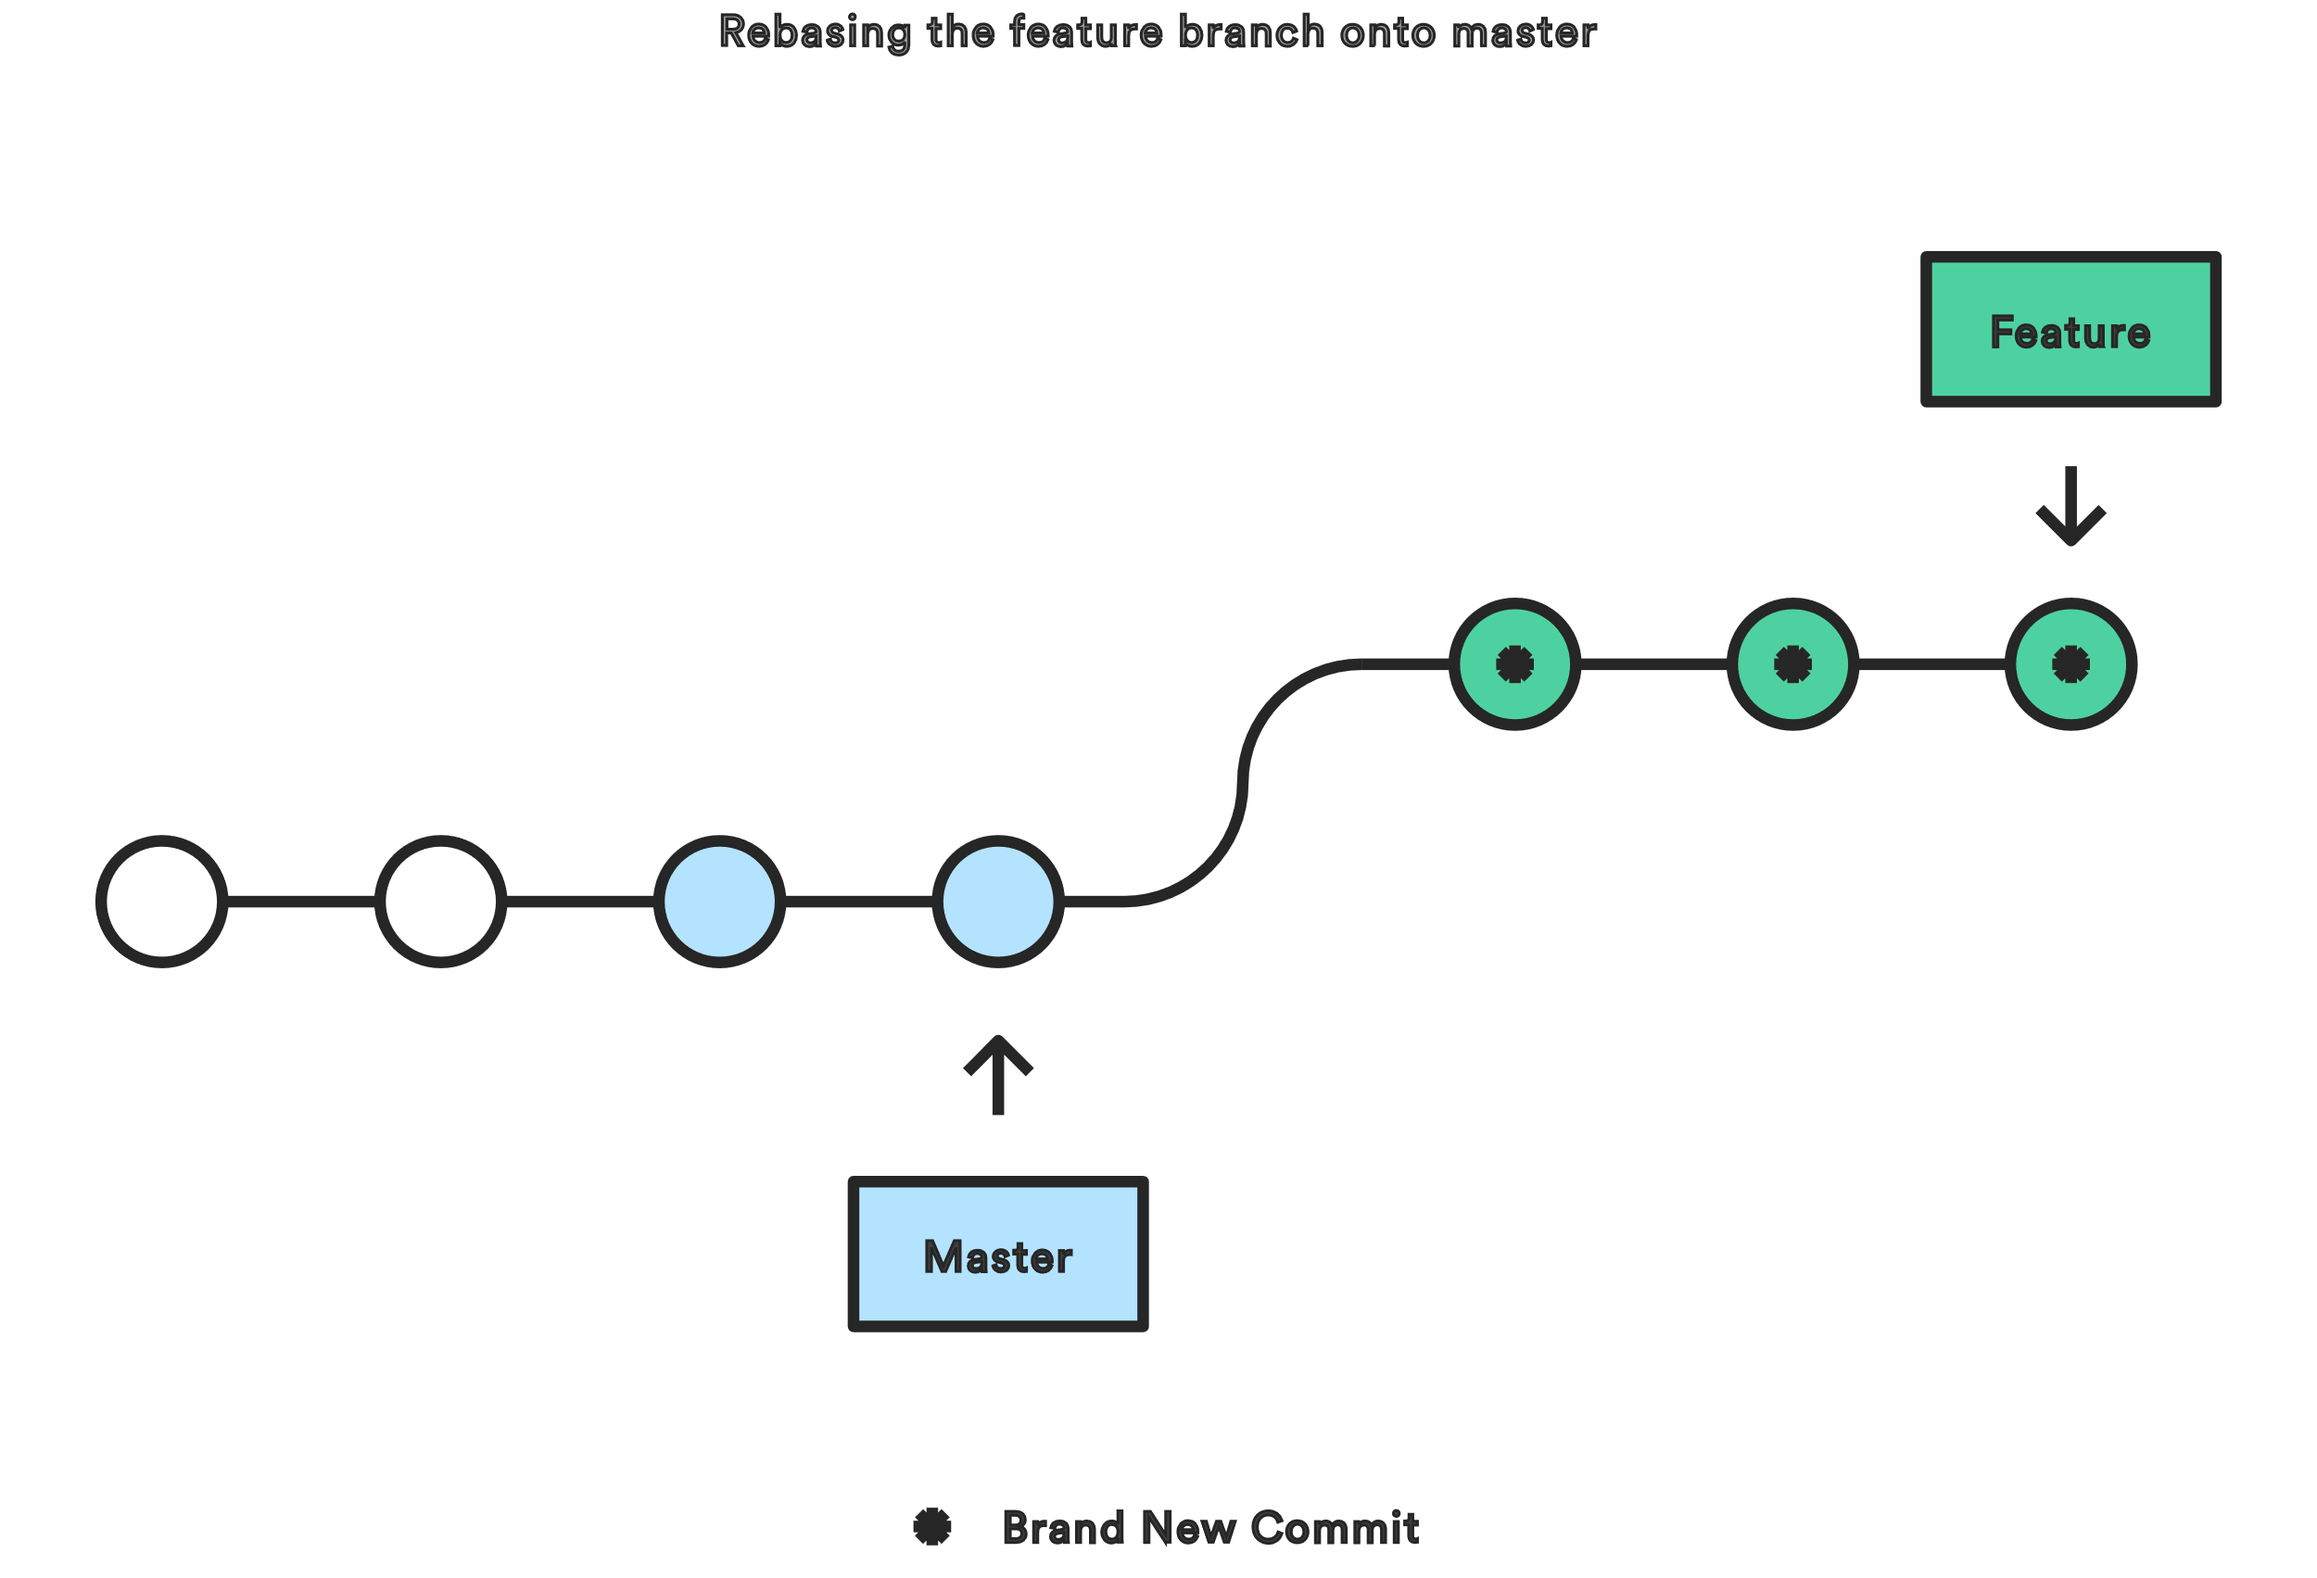
Rebase – Tread carefully (Cont.)

Slide 21
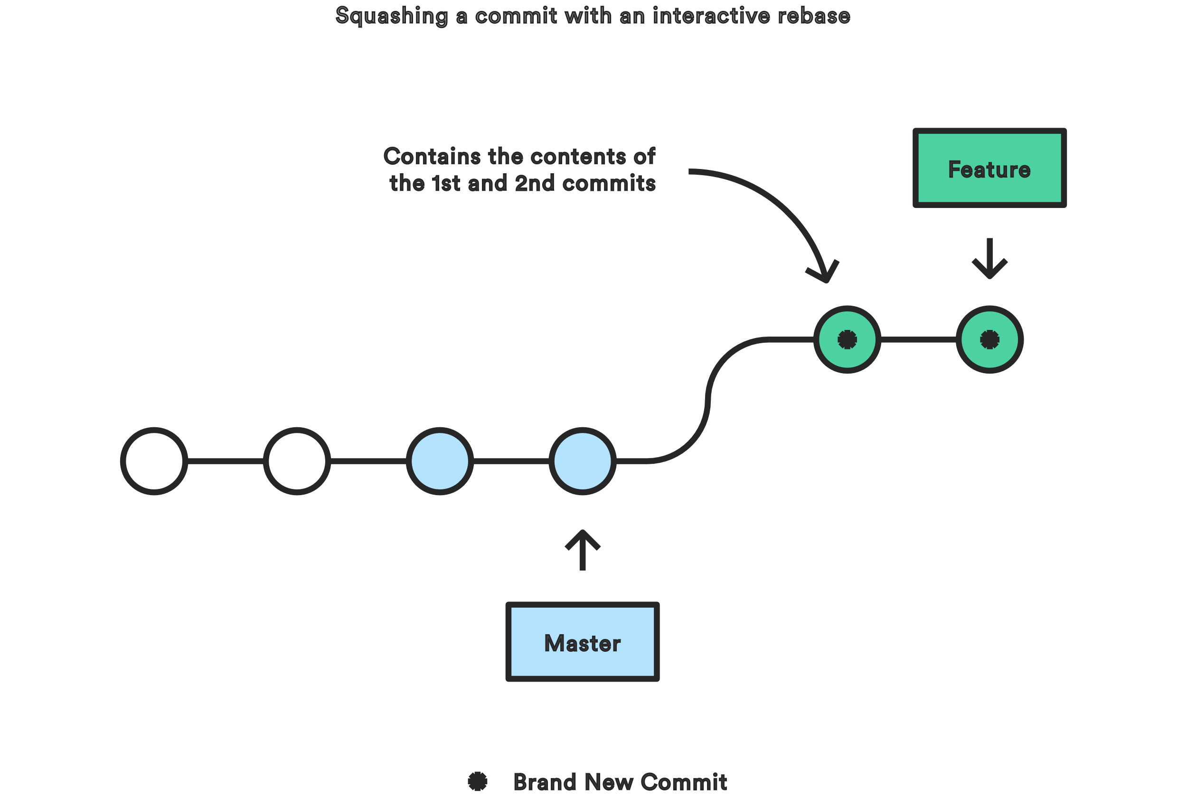
Rebase – Tread carefully (Cont.)

Slide 22
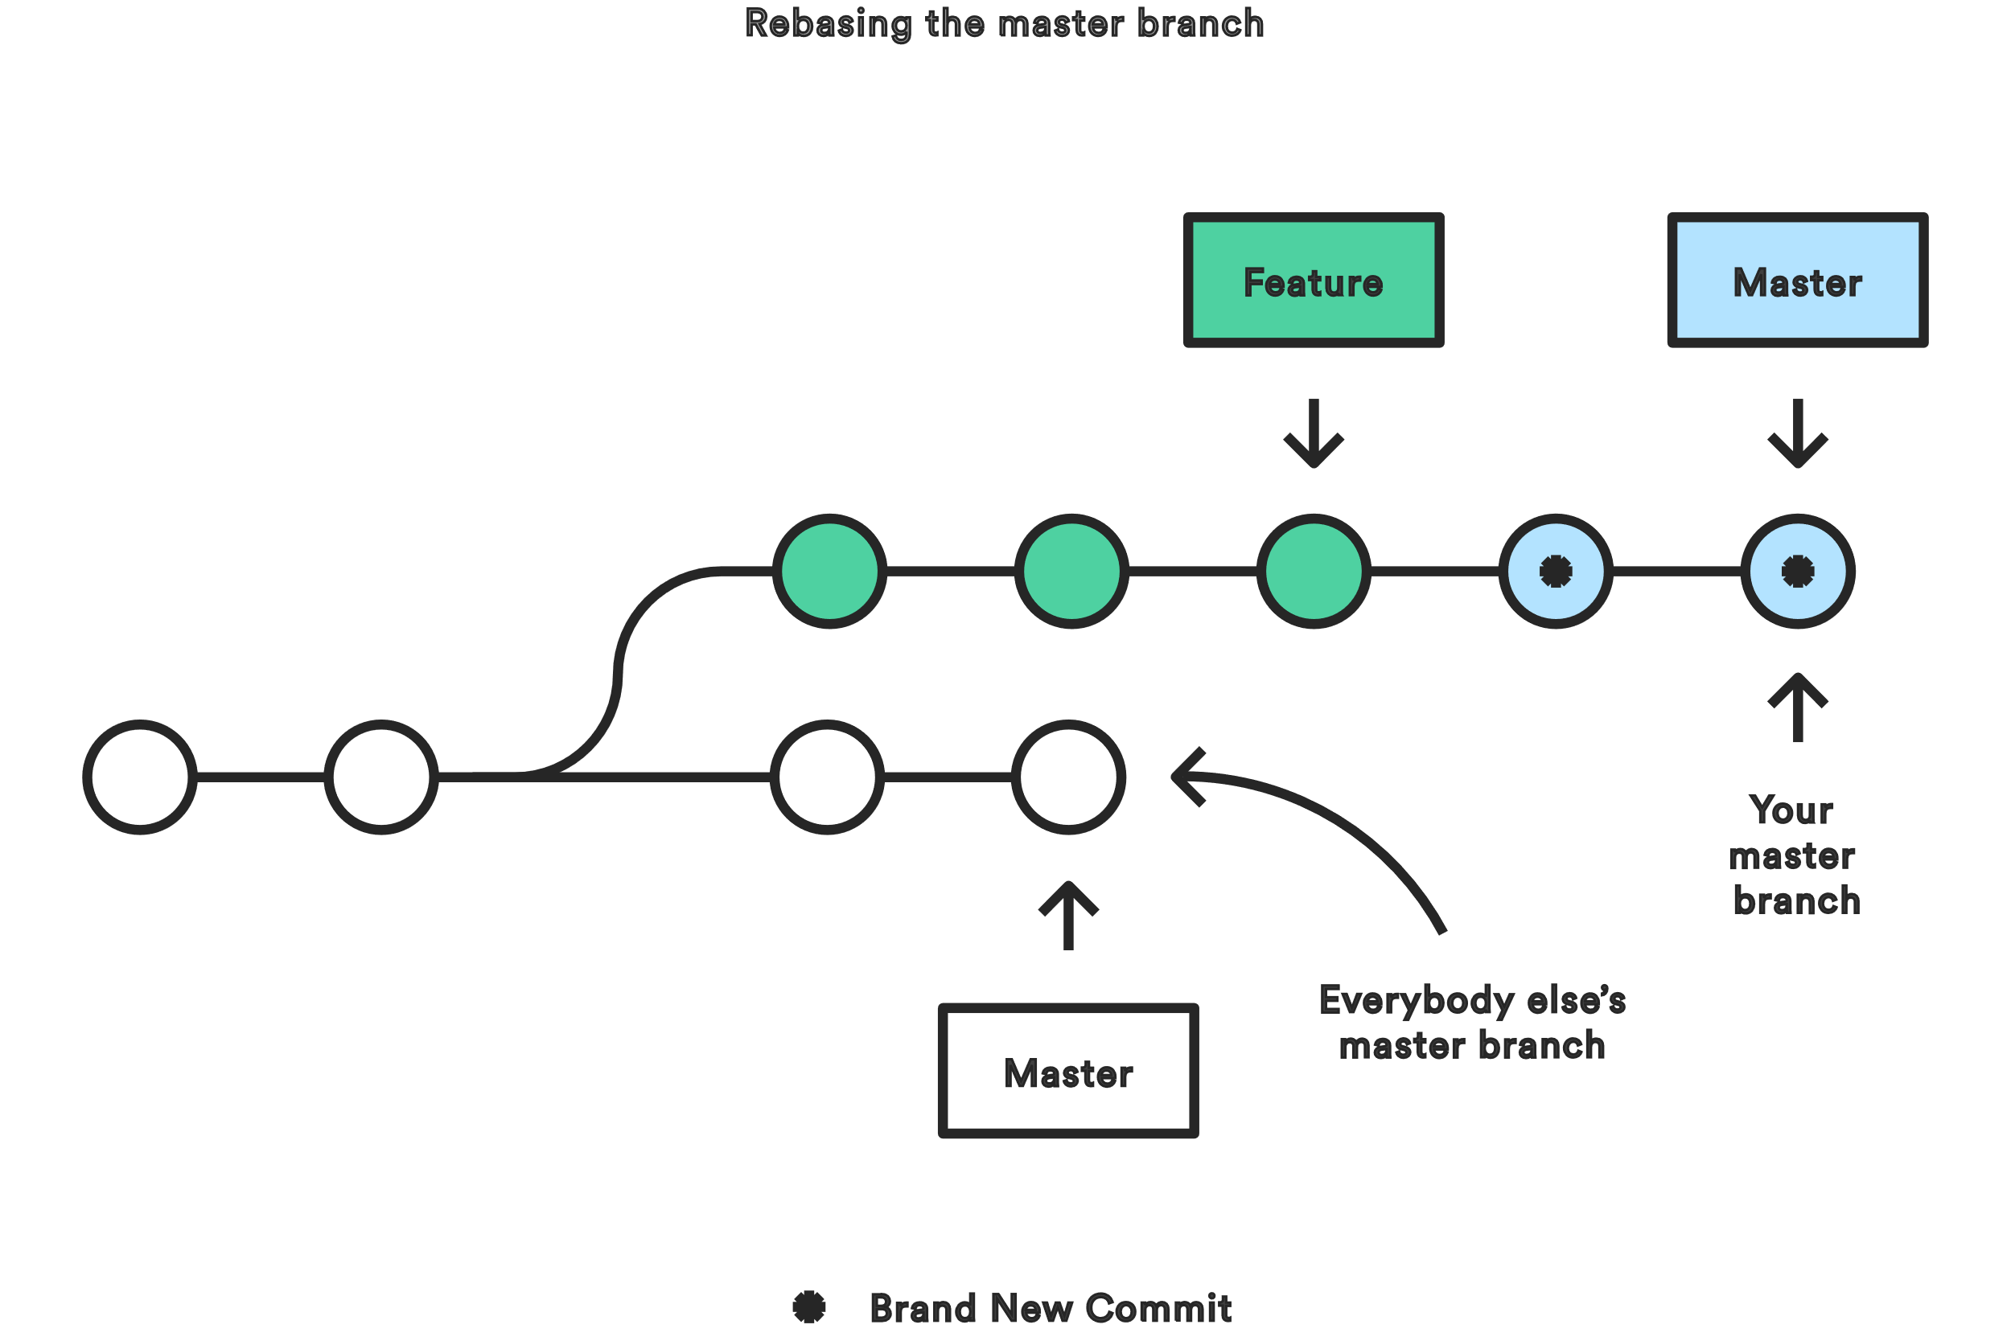
Rebase – Tread carefully (Cont.)

Slide 23
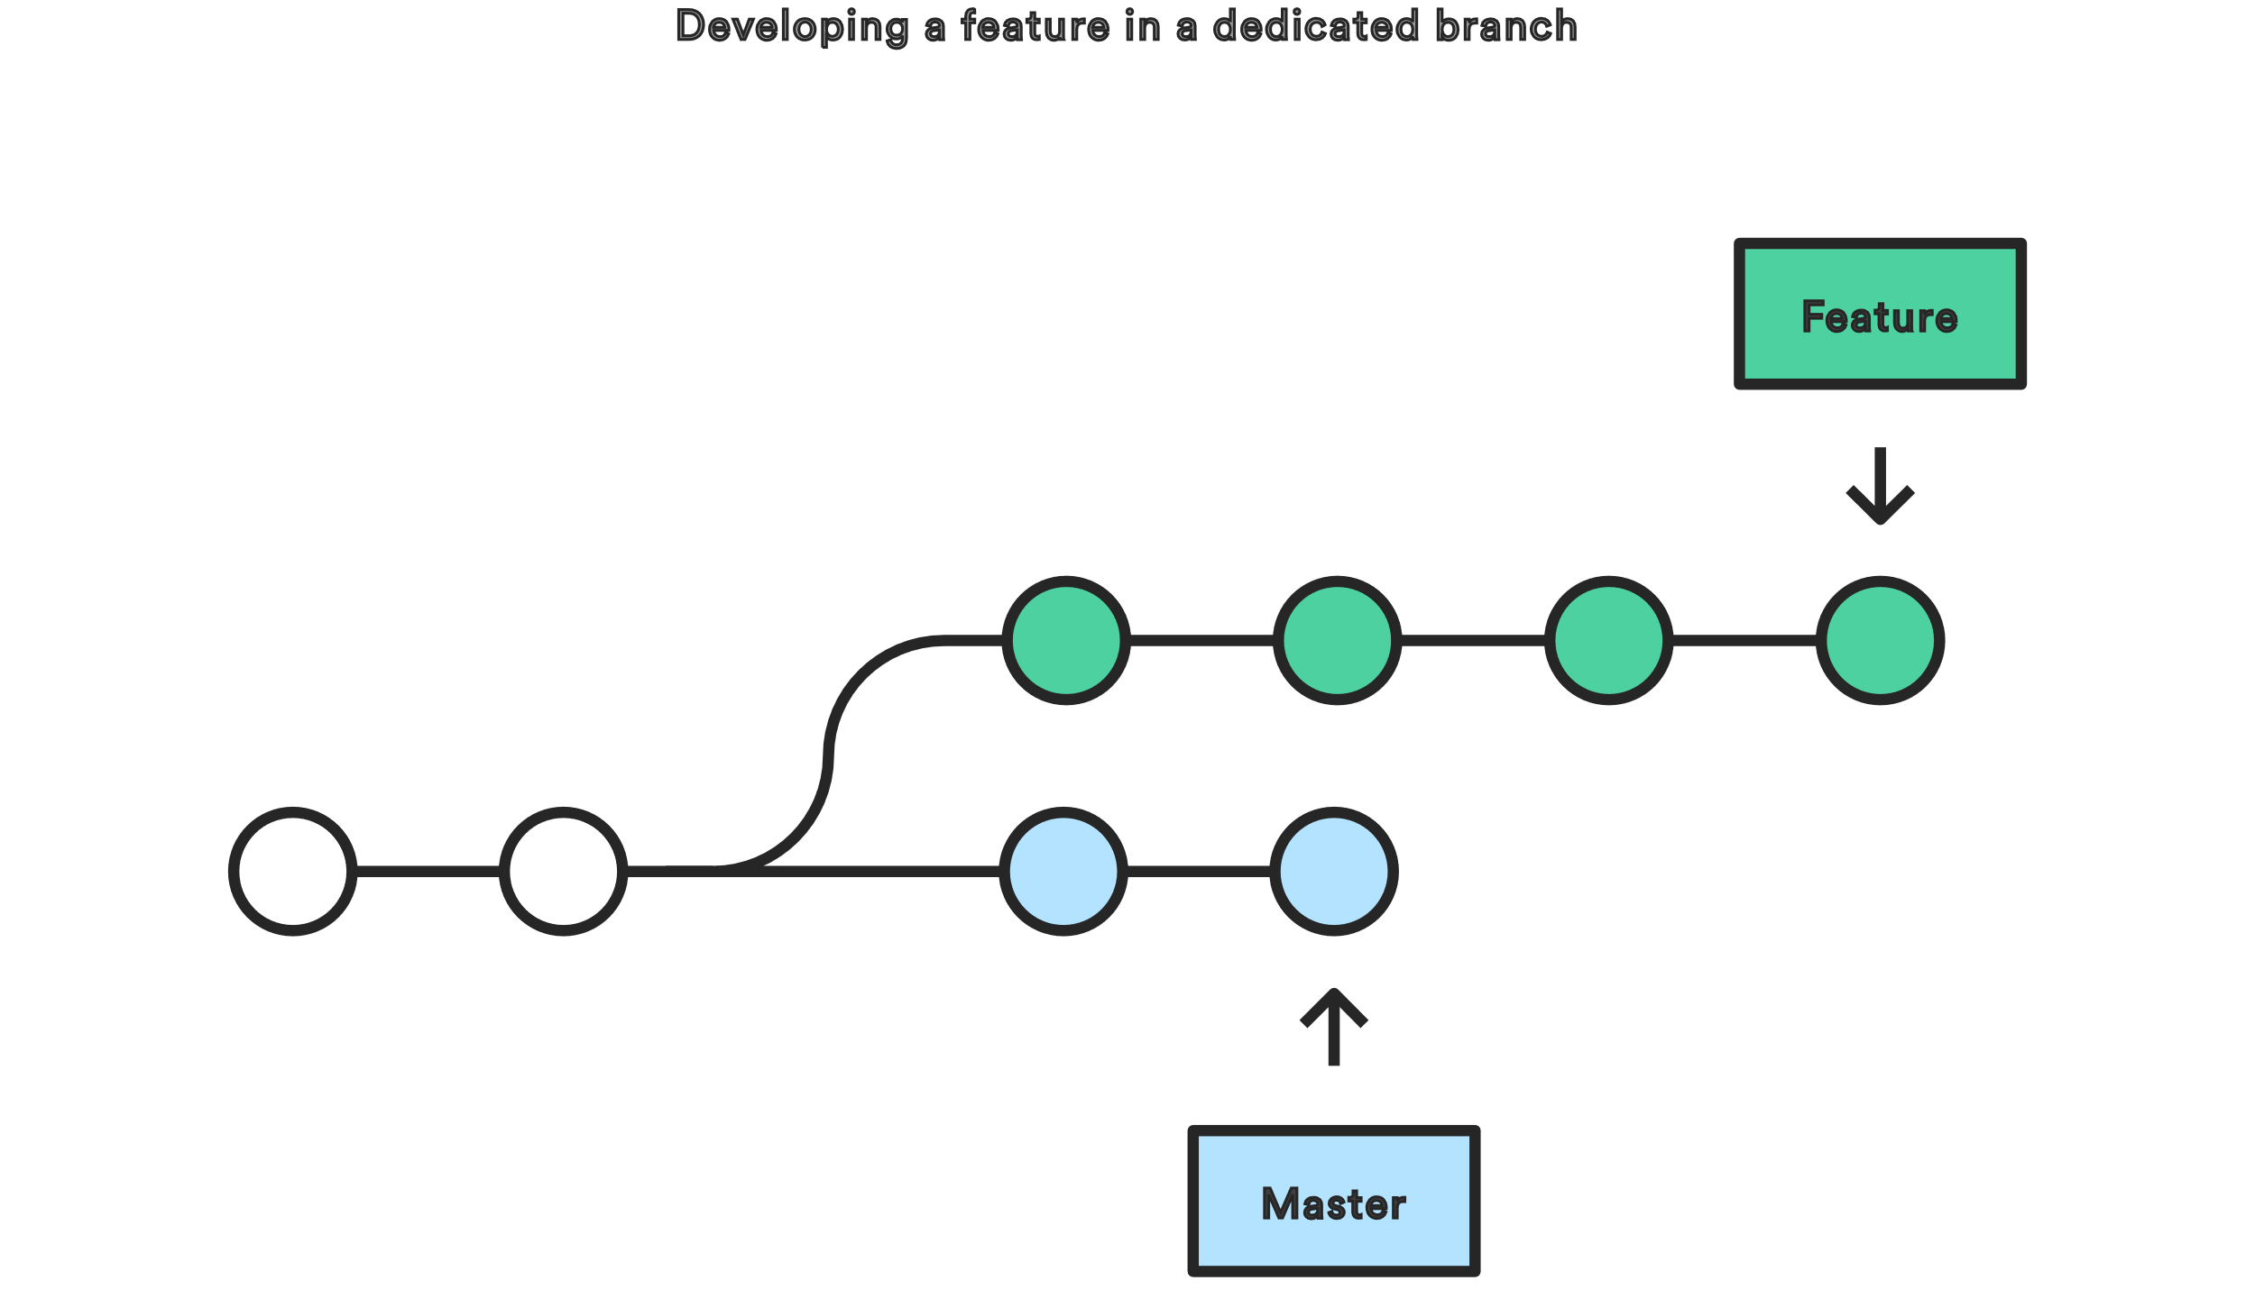
Rebase – Tread carefully (Cont.)

Slide 24
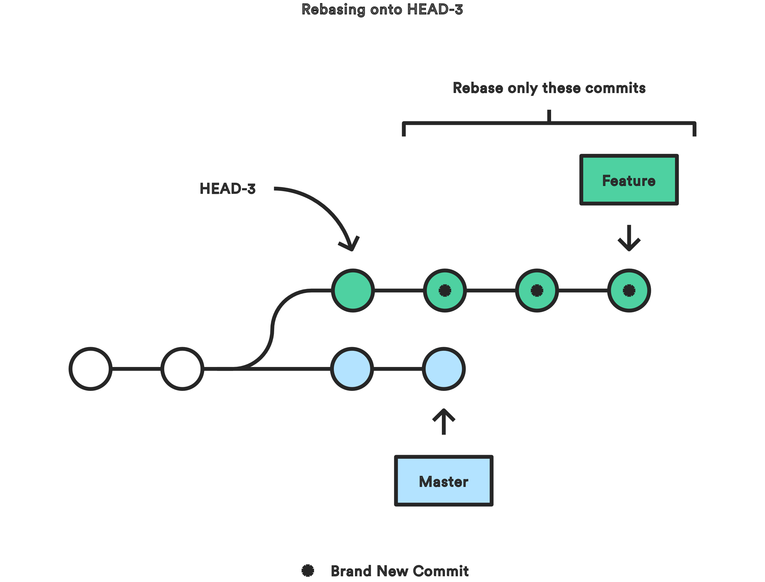
Rebase – Tread carefully (Cont.)

Slide 25
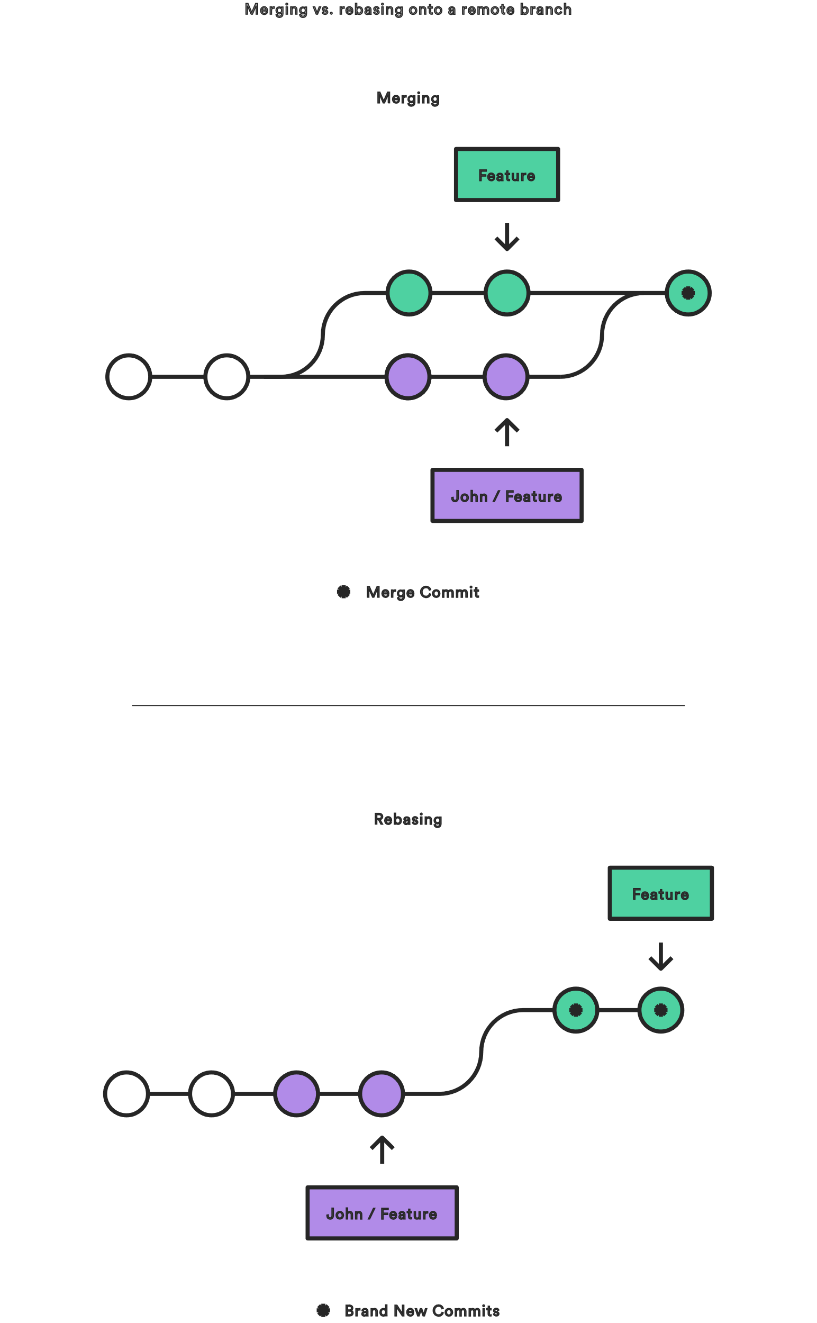

Slide 26
Github features and next steps
Issue tracking
Documentation
Marketplace
Actions
Pages
Social
Topics
Trending
Collections

Slide 27
Presentation End – open lab and questions
Can’t think of a question or need to leave before I can answer?
No worries! Send me an email – zach@zach-martin.com

